Slide 1
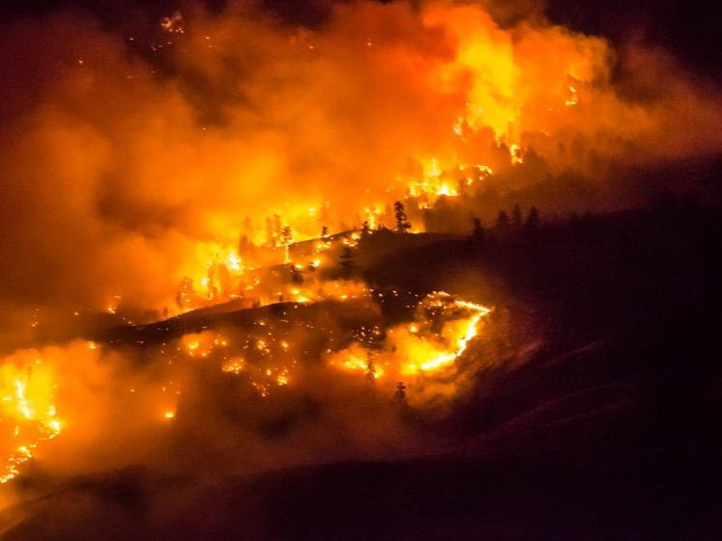

Wildfire 2017: Causes, Consequences & Solutions
to a Wicked Problem
Lori Daniels, Shannon Hagerman and
Sarah Ravensbergen
Faculty of Forestry, UBC - Vancouver
British Columbia Community Forest Association Wildfire Panel
Burns Lake, BC May 26, 2018

Slide 2
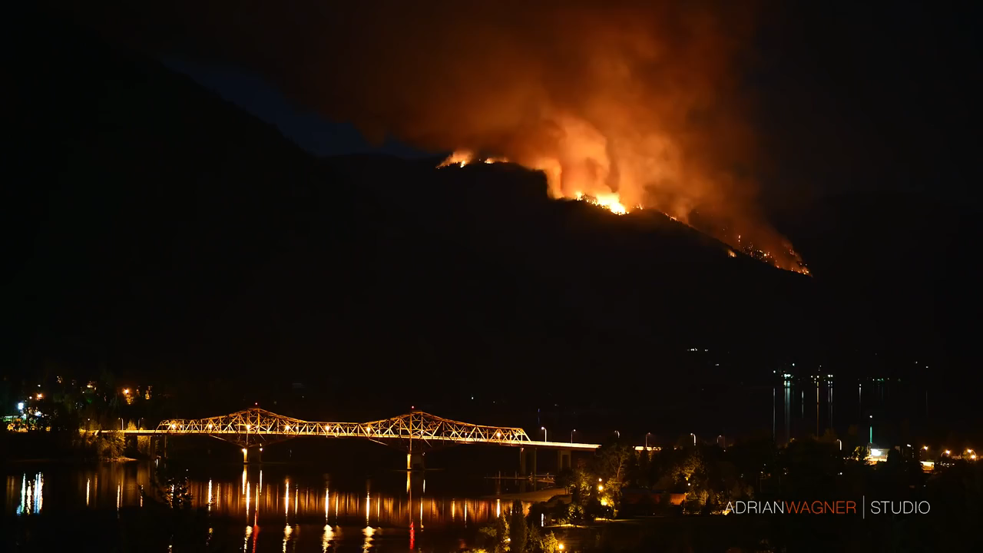
Wildfires of 2017
cannot be another
“wake-up call”
BC’s forests and communities are
not resilient to wildfire + climate change
Transformative change is urgently needed

Slide 3
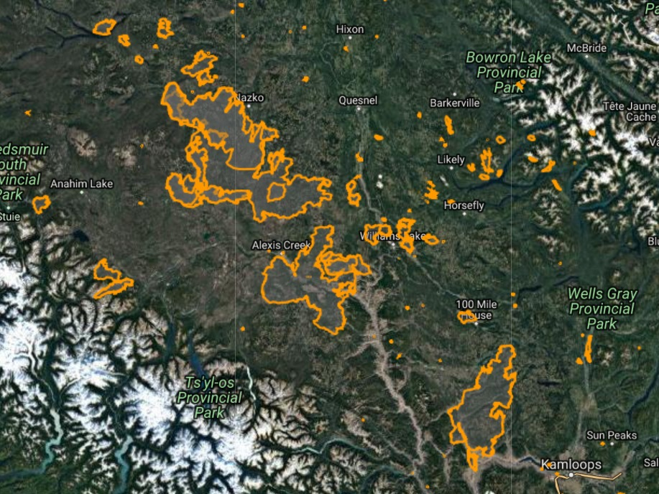
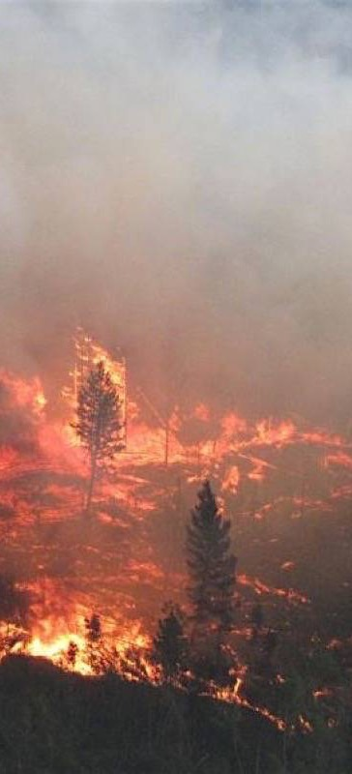
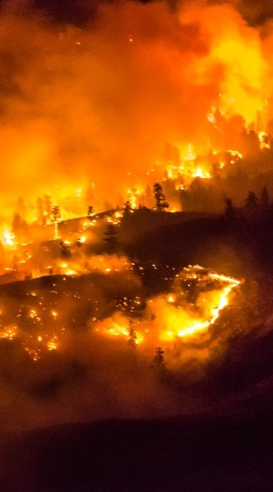
Plateau Complex
521,000 ha
Hanceville-
Riske Creek
239,300 ha
Williams Lake
33,500 ha
Elephant Hill
192,000 ha

Slide 4
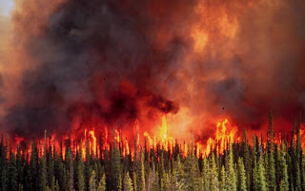
“Wildfire Behaviour Triangle”
topography
weather
fuels

Slide 5
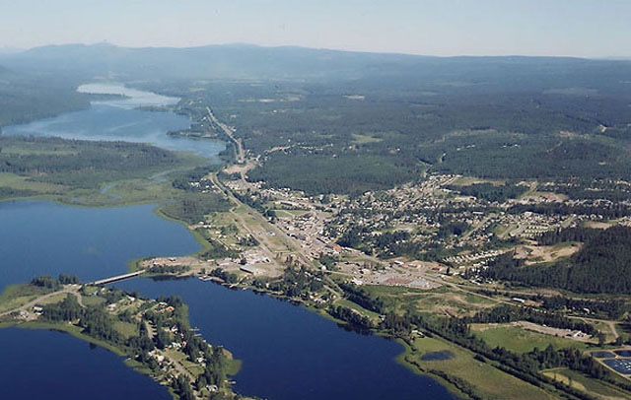
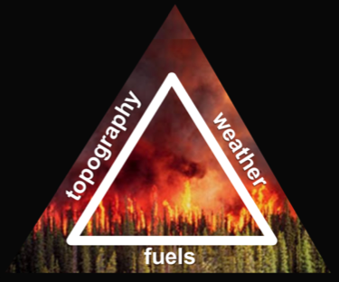
“Wildfire Behaviour Triangle”
Topography includes elevation,
steepness + aspect of slopes.
Of the three axes, topography is most stable in space and time.

Slide 6
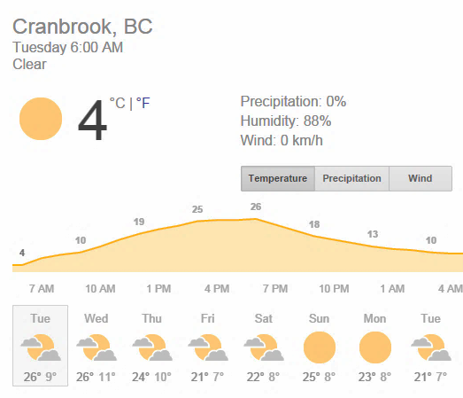
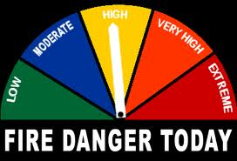
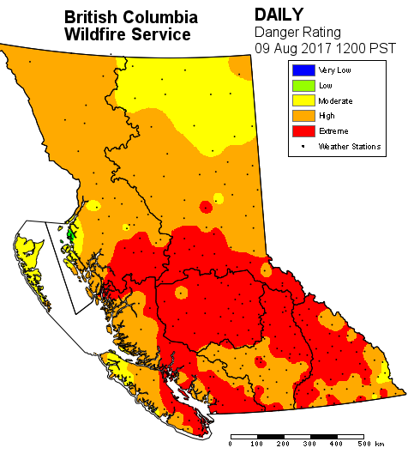
“Wildfire Behaviour Triangle”
Weather varies continually, influencing fire danger
Kelowna, BC
The Weather Channel
BC Wildfire Management

Slide 7
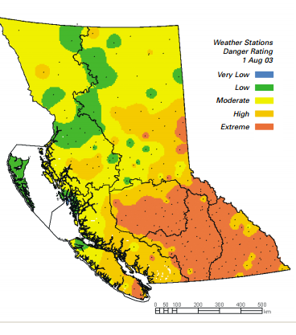
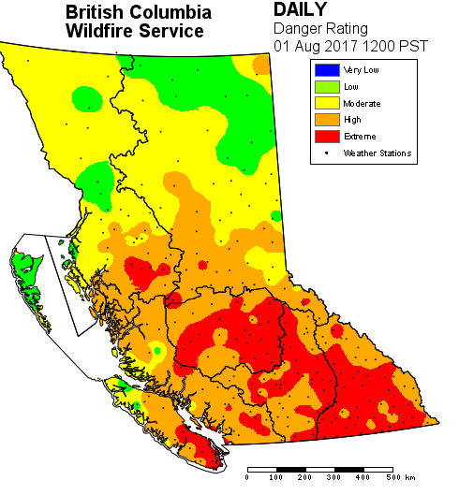
Firestorm 2003
(old benchmark)
August 1 2003
Wildfires and weather in BC are setting new records
(fire danger maps show high to extreme conditions)
State of Emergency 2017
(new reality)
August 1 and 9, 2017
2500 fires
265,000ha burned
$375M to suppress
30,000 evacuees
1323 fires
1,215,746ha burned
$550M to suppress
~65,000 evacuees

Slide 8
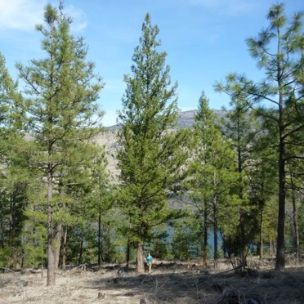
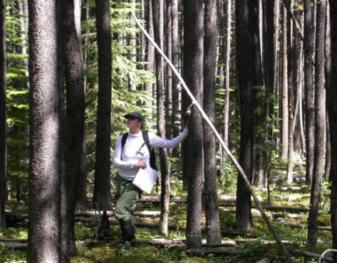
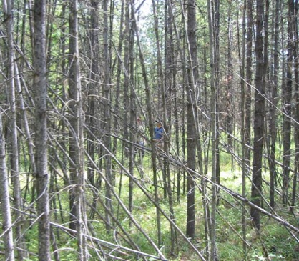
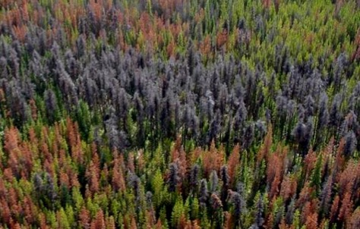
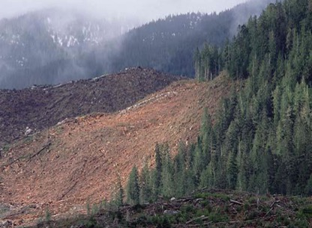
“Wildfire Behaviour Triangle”
Fuels vary among forests
and change through time
as trees grow and forests change after disturbance
Of the three axes, we have the greatest control over fuels.

Slide 9
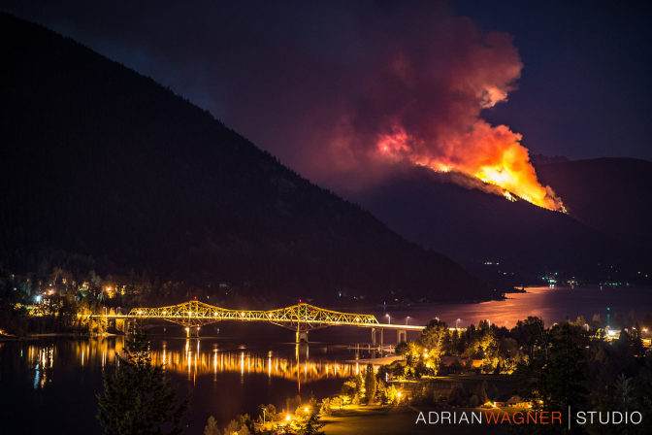
Protection of lives and homes

Slide 10
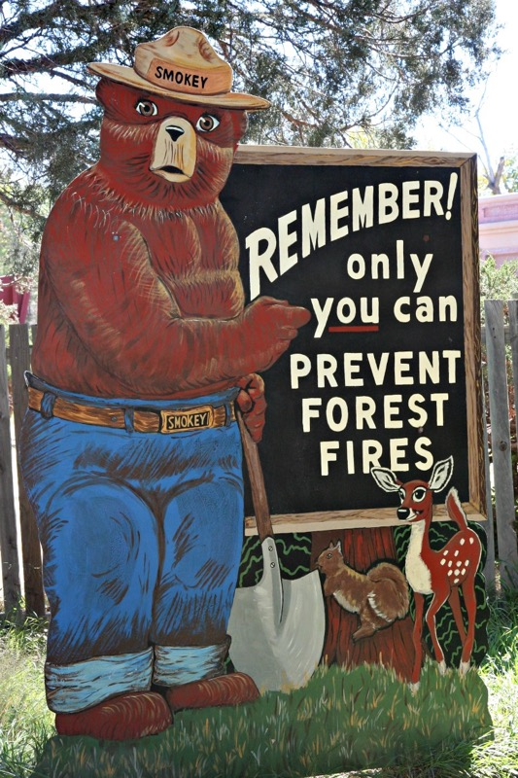
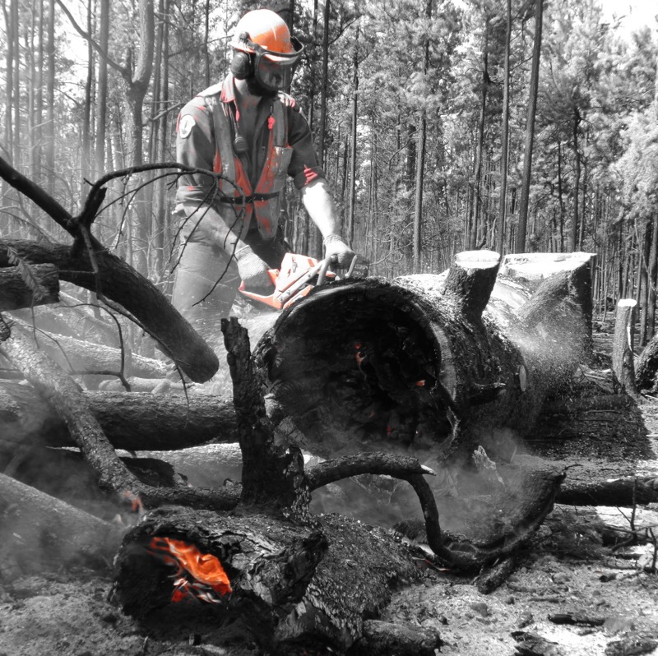
Protection of livelihoods and forests
M. Bray
H. Erasmus

Slide 11
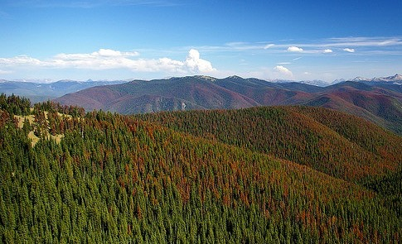
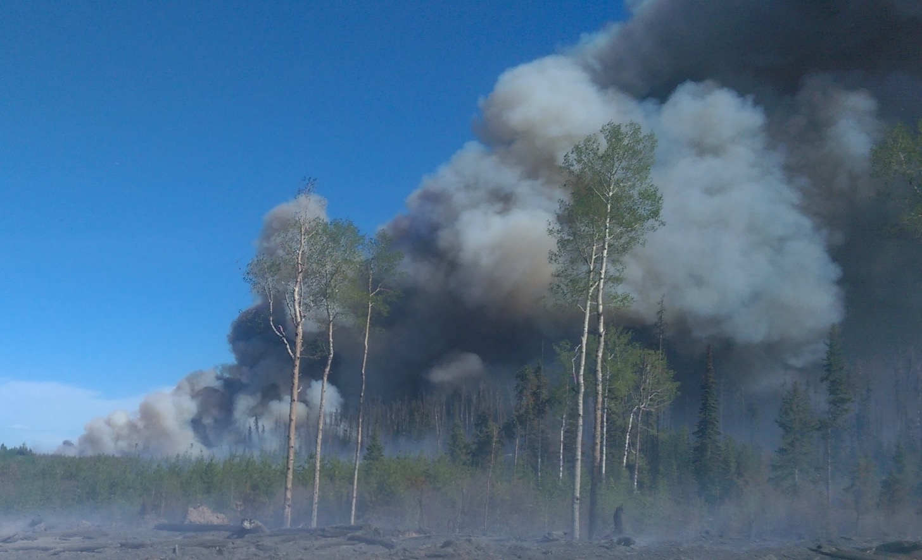
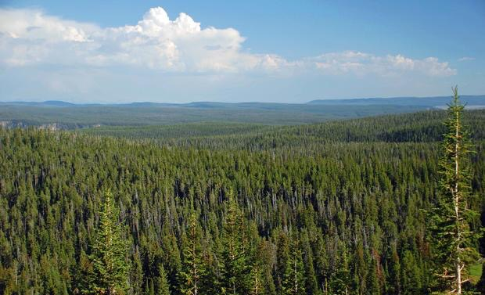
Homogenized landscapes and compromised forest health
California Chaparrall Institute
H. Erasmus
T. Gage

Slide 12
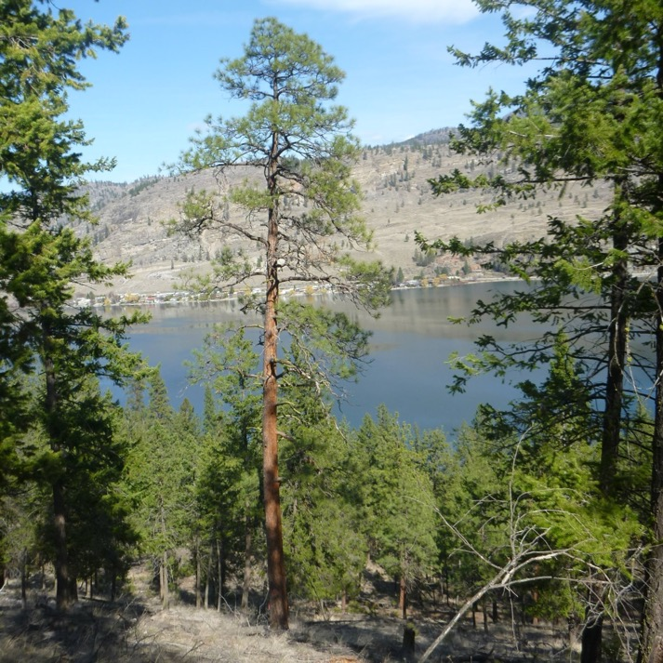
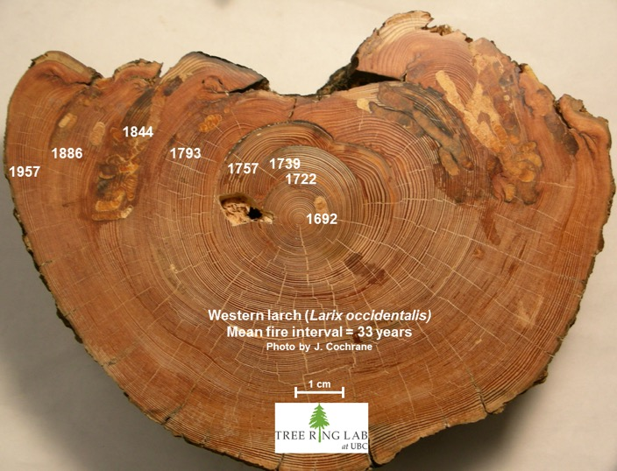
Altered fire regimes and forests
Effectively eliminated
surface fires from
dry forests

Slide 13
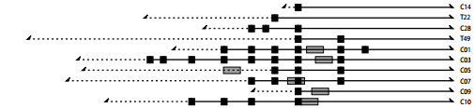
Fire History: Knife Creek, Cariboo
Wesley Brookes, MSc Student
1600 1700 1800 1900 2000
Legend:
Lines = study plots and tree ages
Black square = fire scar
Grey rectangle = cohort of trees

Slide 14
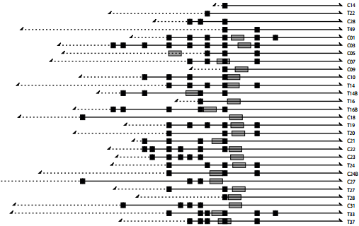
Fire History: Knife Creek, Cariboo
Wesley Brookes, MSc Student
13 fires: 1676-1928
~20 yrs between fires
(range: 9-42 yrs)
No fires after 1928
1600 1700 1800 1900 2000

Slide 15
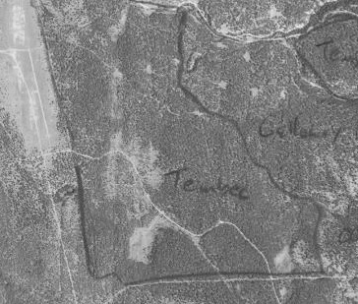
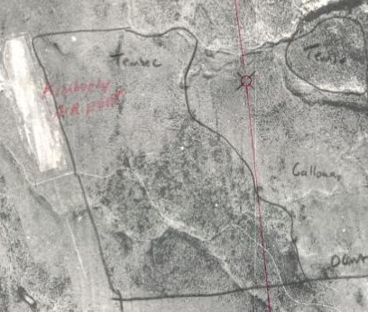
Altered Fire Regimes and Dry Forests
surface
fires
₊
fire exclusion
fuel build-up
decreased grass cover
invasion of trees
increased tree cover
increased tree density
reduced resilience
2004 Near Kimberley, BC
1951 Near Kimberley, BC
A. Neal and R. Harris

Slide 16
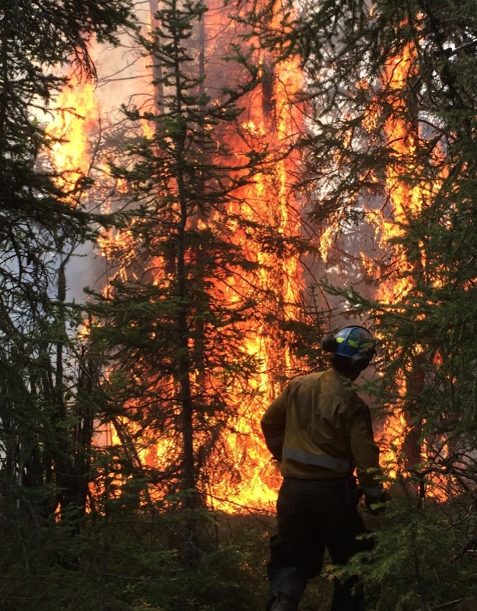
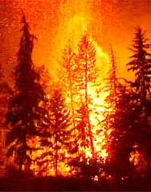
Altered Fire Regimes in Dry Forests
Reduce Forest Resilience
surface
fires
₊
fire exclusion
“fire suppression paradox”
fuel build-up
increased
fire severity
Q. Schmidt

Slide 17
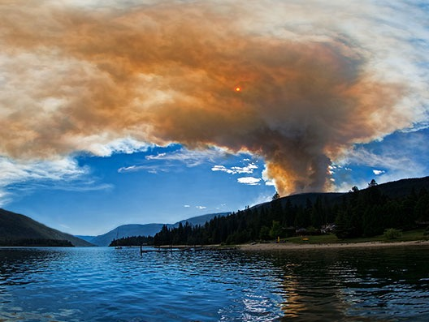
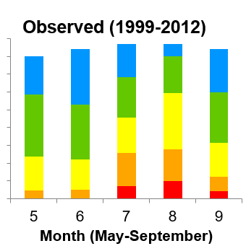
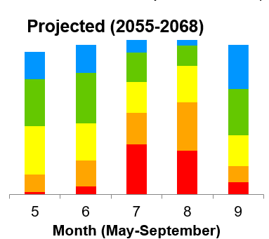
Climate Change: The “New Normal”

Slide 18
Reduced Resilience to Climate Change
surface
fires
₊
fire exclusion
₊
fuels build-up
climate change
more frequent severe fires
Q. Schmidt

Slide 19
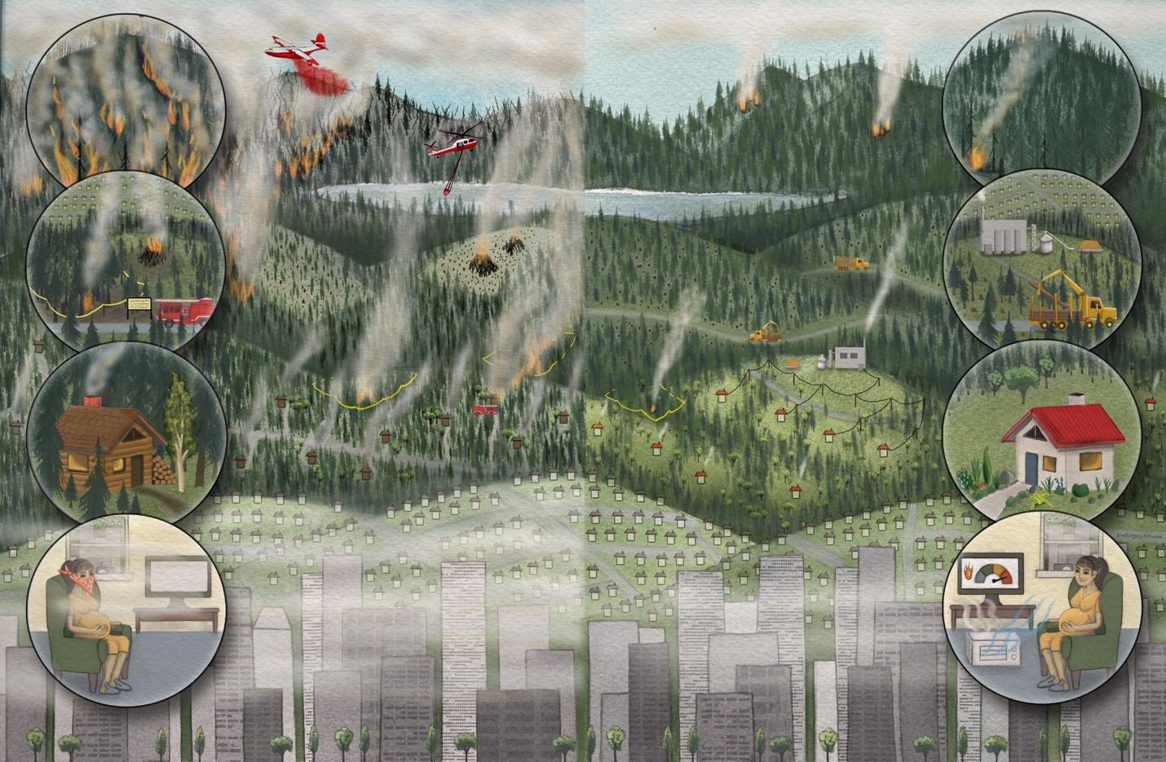
Urgent Need for Transformative Change
“Fire smart”
1.2M ha burns
1.82B fire suppression
$183M fire prevention
Timber + stand-level focus
Homogenized landscapes
Vulnerable communities
Naïve citizens
Lack of political will
Artwork: Jen Burgess
Bowman et al. in prep.

Slide 20
Urgent Need for Transformative Change
Artwork: Jen Burgess
Bowman et al. in prep.

Slide 21
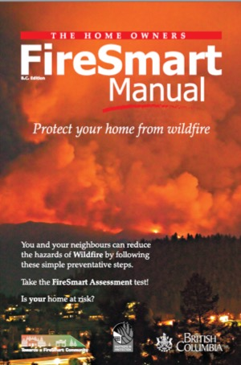
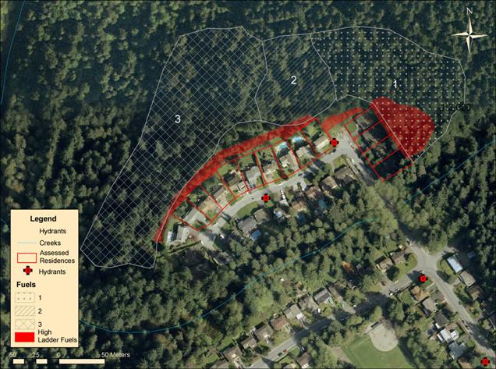
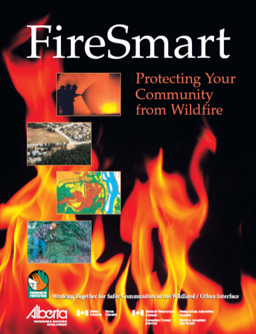
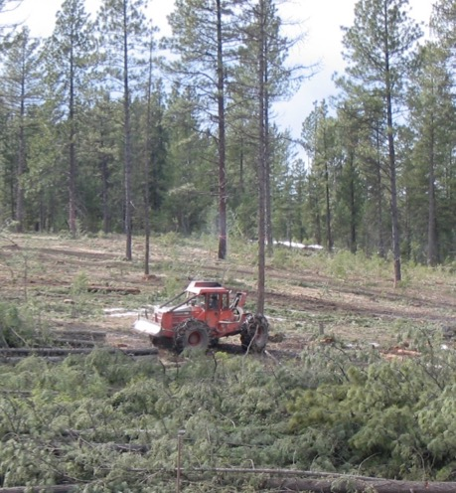
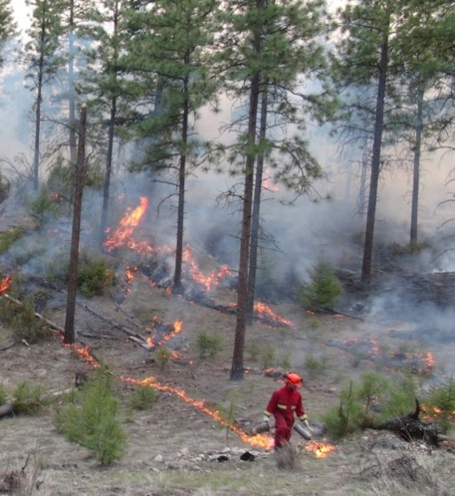
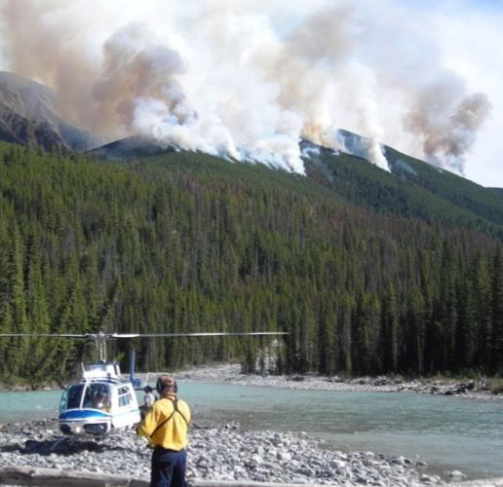
Resilience: Learning to Live with Fire

Slide 22
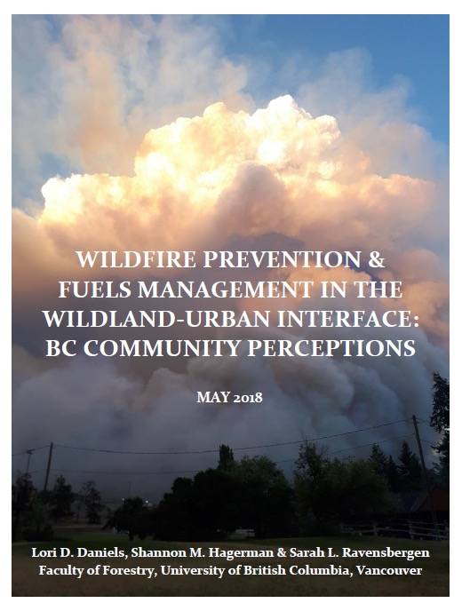
Community Initiatives: Barriers + Solutions
In 2004
1.6M ha hazardous fuels
wildland-urban interface
By 2017
$74M fuels mitigation
11, 679 ha treated
($6336 per ha)
$3B suppression
$19B seismic upgrades

Slide 23
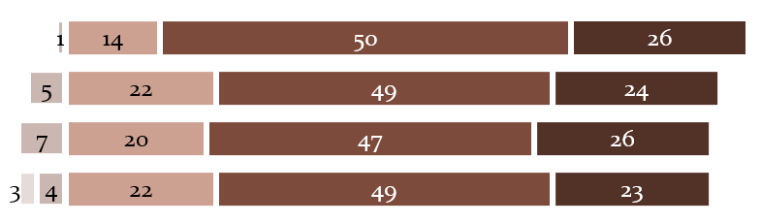
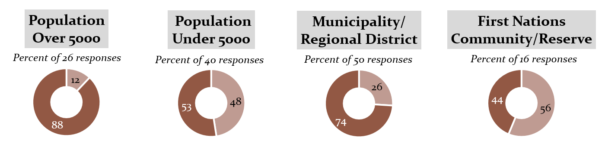
Wildfire: Urgent priority but several barriers
Findings of our 2016-7 survey:
Relative urgency of wildfire in 74 communities:
Not Urgent ……………… ………………….Very Urgent
Wildfire in WUI
Economic development
Emergency plans
Health care
Daniels, Hagerman and Ravensbergen 2018

Slide 24
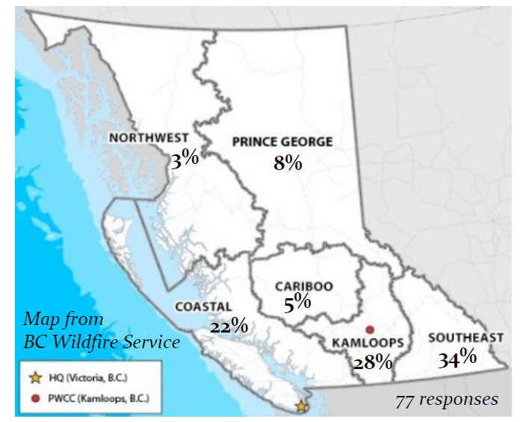
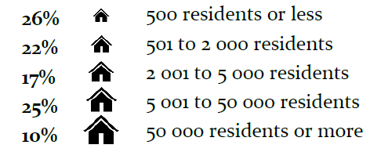
Wildfire: Invitation to participate
in 2018 survey to better represent all of BC
Will you join us to
co-develop solutions to overcome barriers?
Daniels, Hagerman and Ravensbergen 2018

Slide 25
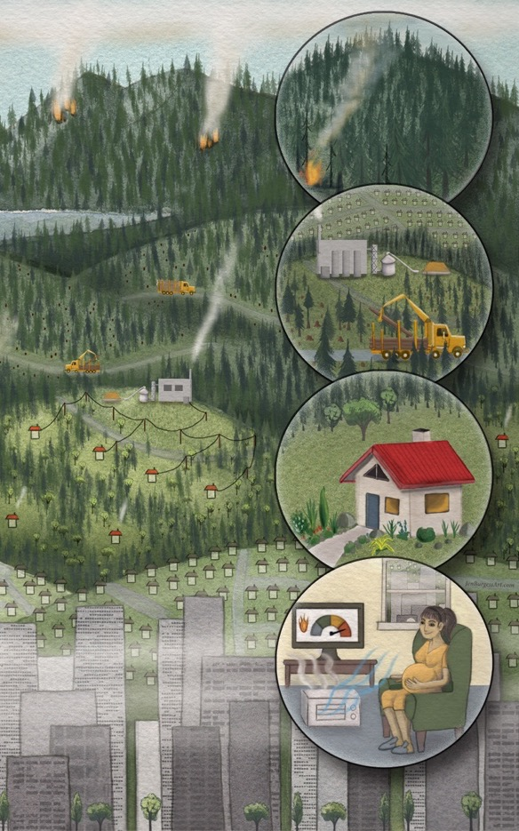
Resilience: Learning to Live with Fire
Community-based Approach:
WUI zoning and treatment
for low fire hazard
Proactive landscape planning reinforces WUI treatments
Coupled with FireSmart
Science and TEK inform forest restoration and management
Evidence-based, adaptive, and tested for efficacy

Slide 26
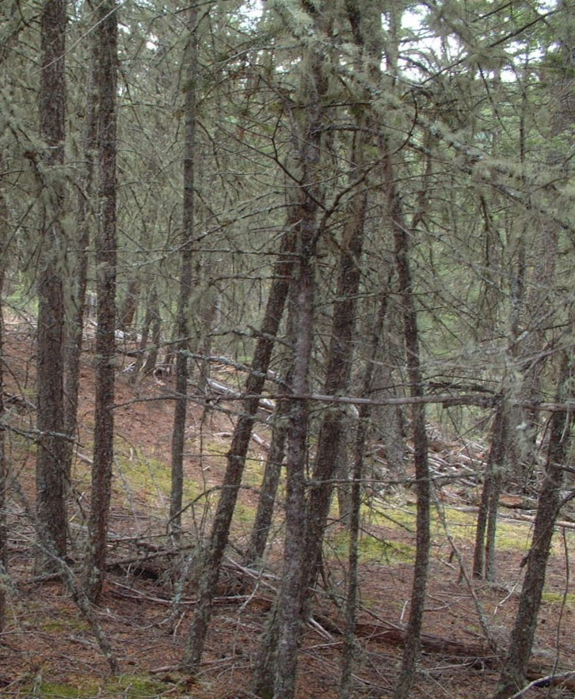
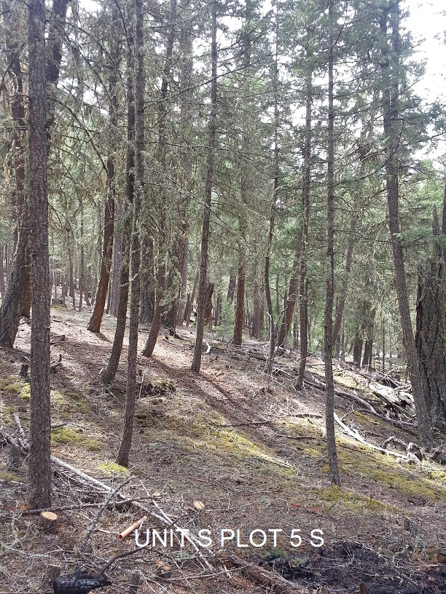
Are our treatments effective?
Fire weather thresholds?
“defensible space”
Would you like to partner with UBC to measure effectiveness of treatments?

Slide 27

Post-Fire Recovery and Resilience
2017 Hanceville-Riske Creek Fire
How accurate are fire severity maps?
Amount of fuel? What is regenerating?

Slide 28


Post-Fire Recovery and Resilience
2017 Gustafson Lake Fire
Ensure post-fire treatments reduce risk of
future high-severity fires.

Slide 29



Post-Fire Recovery and Resilience
Evidence-based – Adaptive – Test for efficacy
2015
Mixed-severity
2016
No salvage
2016
Salvaged
Would you like to partner with UBC to measure fire and treatment effects?

Slide 30



Adaptations to Improve Forest Resilience
Diversify forest management across scales
landscapes – stands – individual trees

Slide 31

Resilience: Learning to Live with Fire
Will the BC government
have the will and courage to act?

Slide 32
British Columbia has opportunity to be a world-leader in adaptation to climate change.
To make our forests and communities resilient requires transformative change.

Slide 33
BC
2017
Wildfire Index*
Total number of fires: 1,323
Ignitions by lightning on July 7: >160
Days in a provincial state of emergency: 70
Number of temperature records “shattered” this summer: 85
Percent of province in moderate to extreme fire danger on August 10 and 11: >99
Size in hectares of the Plateau Wildfire, BC’s largest “blaze” on record: 521,024
Record area burned in hectares, despite modern technology and suppression efforts: 1,215,746
Tonnes of greenhouse gas emissions from wildfire, 3x the provincial annual average: 190,000,000
Air Quality Health Index, on a scale of 1 to 10, for Kamloops on August 3: 49
Estimated number of evacuees fleeing wildfire: 65,000
Estimated number of buildings lost: 417
Number of recommendations in the BC Flood and Wildfire Review: 108
Overlap with our white paper: 44
*Inspired by Harper’s Index, compiled by Dr. Lori Daniels
Figures cited are the latest available as of March, 2018

Slide 34

Cranbrook Fire Zone
(Apr-Oct, 1991-2012):
942 lightning ignitions
191 in valley bottom
dry forests
Area burned:
194 ha in total
97% <4ha
3% = 21ha (avg)
max = 52ha
Explanations:
Ignitions occur during unsuitable weather?
Fires cannot spread?
Fires are suppressed?

Slide 35

Open forests (n=88)
Old closed forests (n=34)
Young closed forests (n=46)
surface, intermittent, crown

Slide 36

Fire Regimes in British Columbia
Natural Disturbance Type (NDT) Classification
1 High severity
250-350 years
2 High severity
200 years
3 High severity
100-150 years
4 Low severity
4-50 years
5 Non-fire
Assumption:
If we classify correctly
and stay within these parameters, then we will manage timber sustainably and maintain biodiversity

